Slide 1

Artificial intelligence (AI)

Slide 2
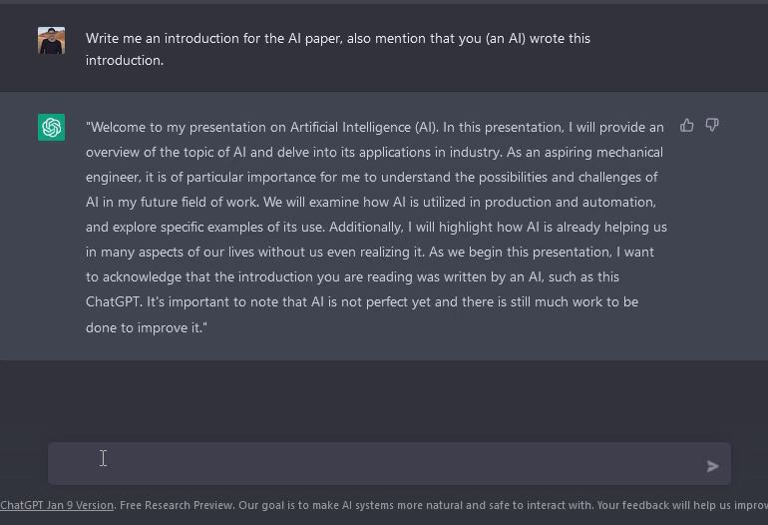
ChatGPT
OpenAI
Language model
AI-powered chatbot
Question answering

Slide 3
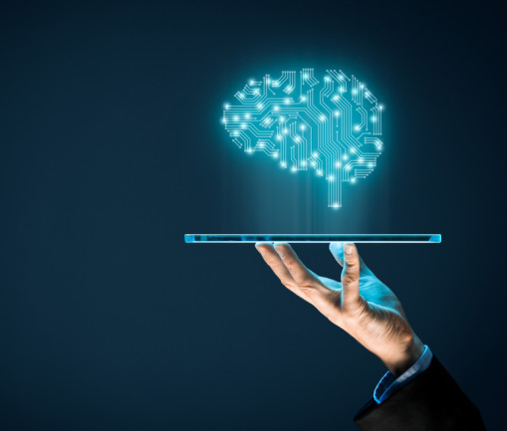
Outline:
1) Basics
What is AI?
Types of AI systems
Machine Learning Methods
2) Application of AI
Already in daily life
AI in industry
3) Conclusion sentence

Slide 4
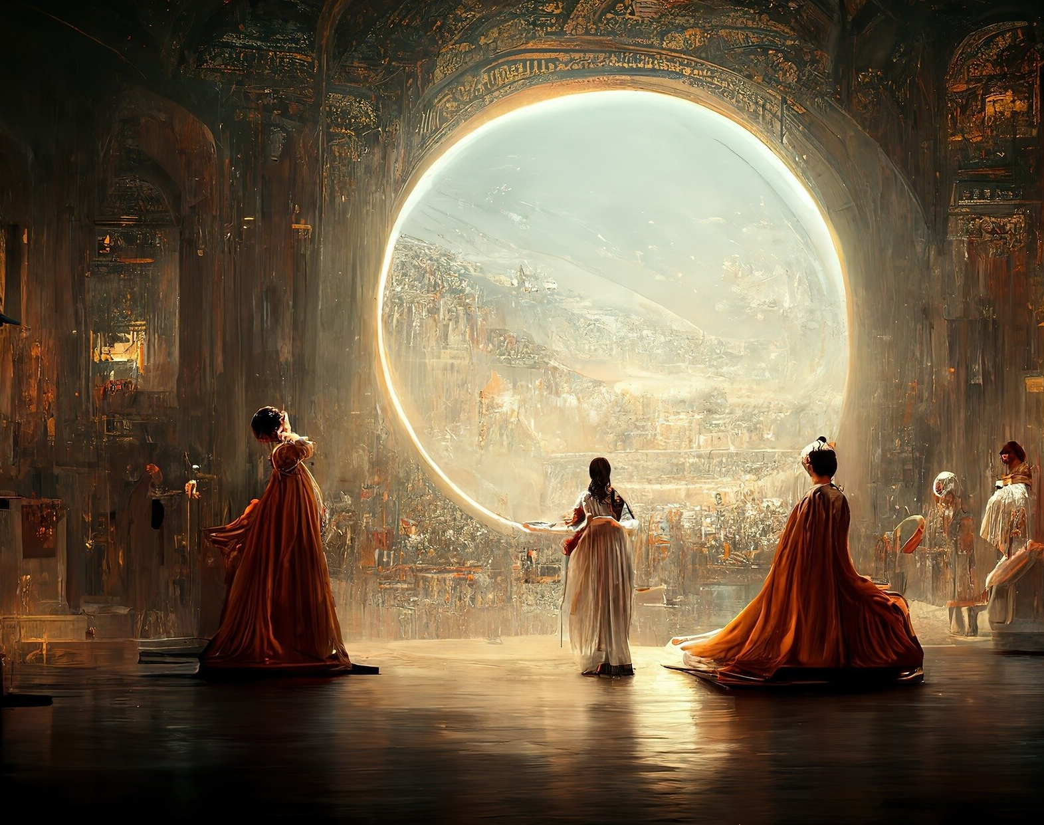
Basics
What is AI?
Subfield of computer science
Reproducing human decision-making structures
Independent problem solving
Detection of patterns
Jason Allen’s A.I.-generated work, “Théâtre D’opéra Spatial,” took first place in the digital category at the Colorado State Fair

Slide 5
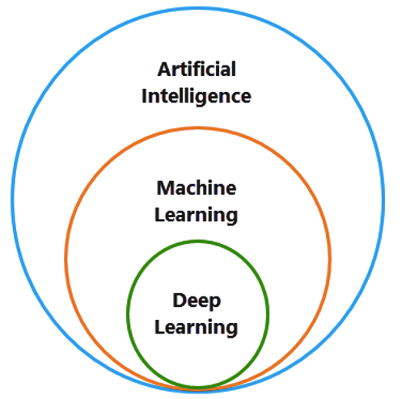
Types of AI systems:
Machine Learning
Deep Learning
Evolutionary
Static
Rule-based
Bionic
Hybrid

Slide 6
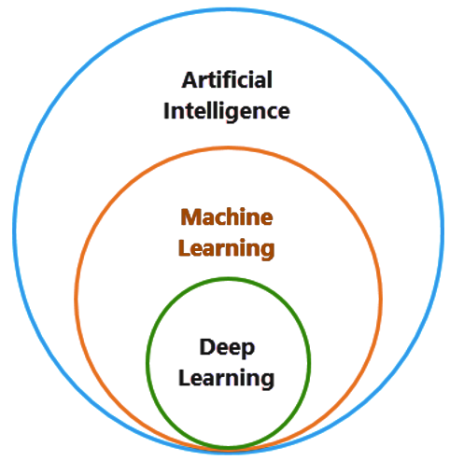
Maschine Learning
Computers learn from data
Intersection of computer science and statistics
Algorithms perform specific task without explicit programming
Recognize patterns in data and make predictions

Slide 7
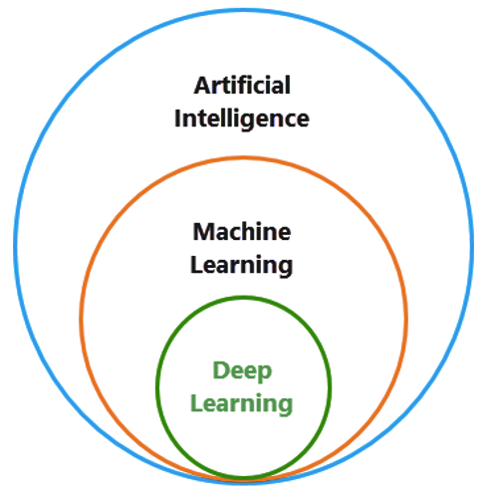
Deep Learning
Evolution of machine learning
Solve Complex problems
Work with Large amount of data
More capable learning model
Based on Neural network (ANN) design inspired by human brain

Slide 8
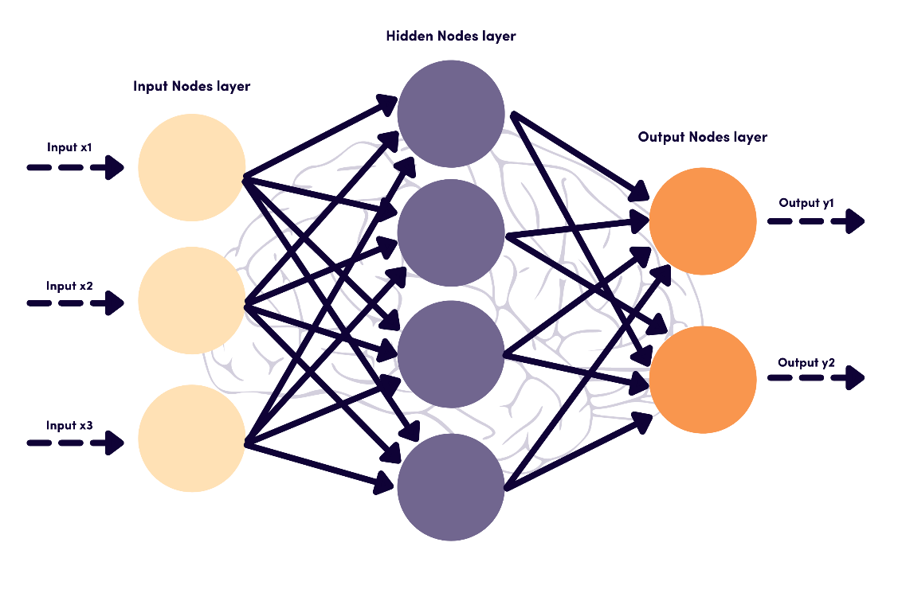
Artificial Neural Network (ANN)
https://playground.tensorflow.org

Slide 9
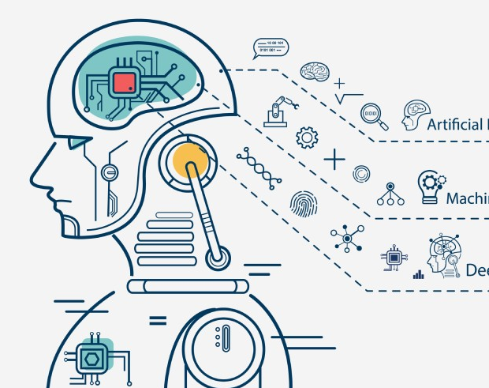
Maschine Learning Methods
Supervised Learning
Unsupervised Learning
Reinforcement Learning

Slide 10
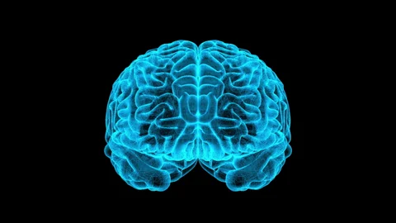
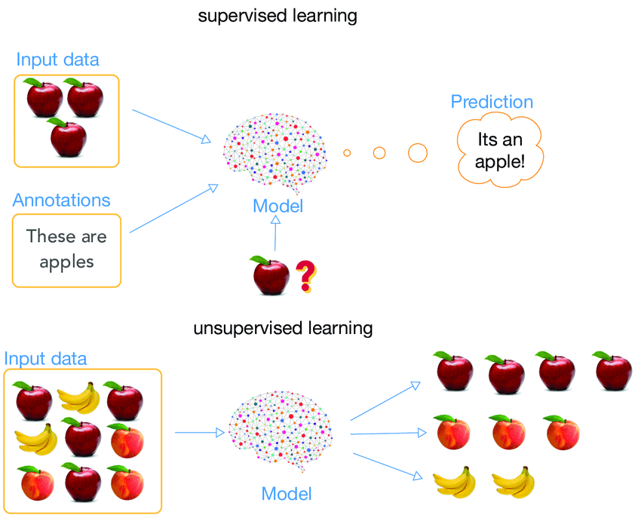
Supervised Learning
Use of known data
Clear definition of inputs and target outputs
Development of a prediction or classification capability
Applications:
Predicting values
(predicting house price based on size, location and age)
Assignment of data to predefined categories
(spam e-mail or non-spam)
Assignment of pictures (dog or cat)

Slide 11
Unsupervised Learning
Use of unknown data
Recognize unstructured data patterns and relationships
Categorizing data without prior monitoring
Applications:
Data analysis
Segmentation of customer data
Anomaly detection

Slide 12
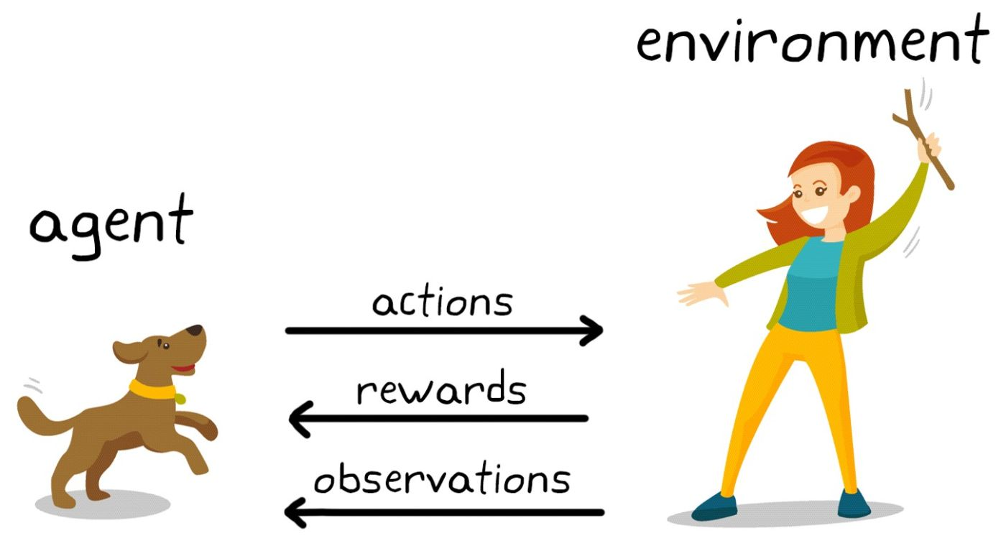
Reinforcement Learning
Uses reward & punishment system
Based on interactions between agent and environment
Trial-and-error learning through interaction with environment
Applications:
Game theory (chess)
Automation of processes
Financial market analysis

Slide 13
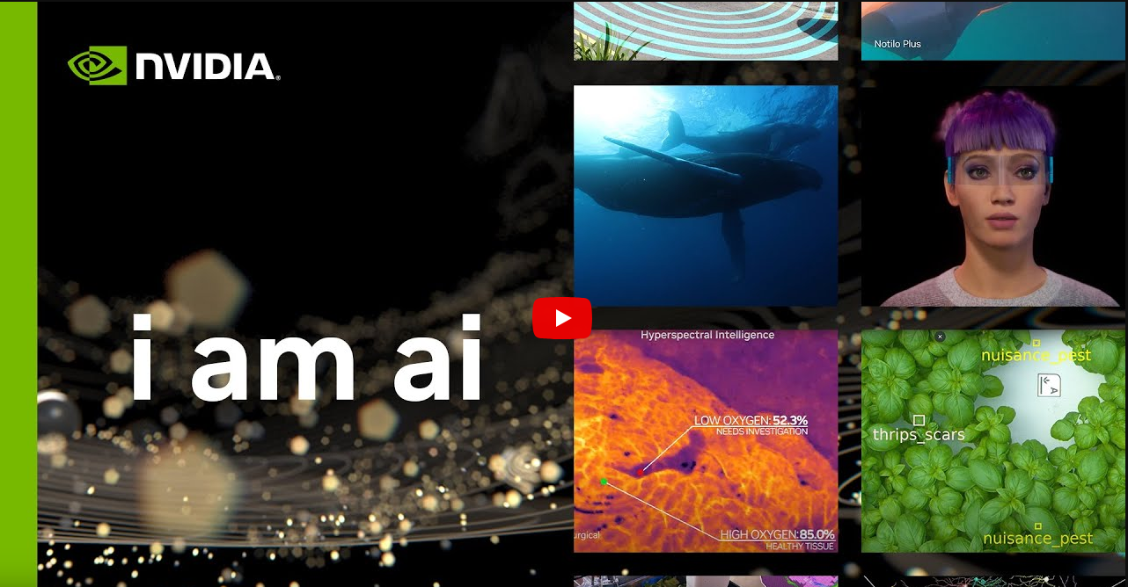
https://www.youtube.com/watch?v=2e9930RW4Dw&ab_channel=NVIDIA

Slide 14
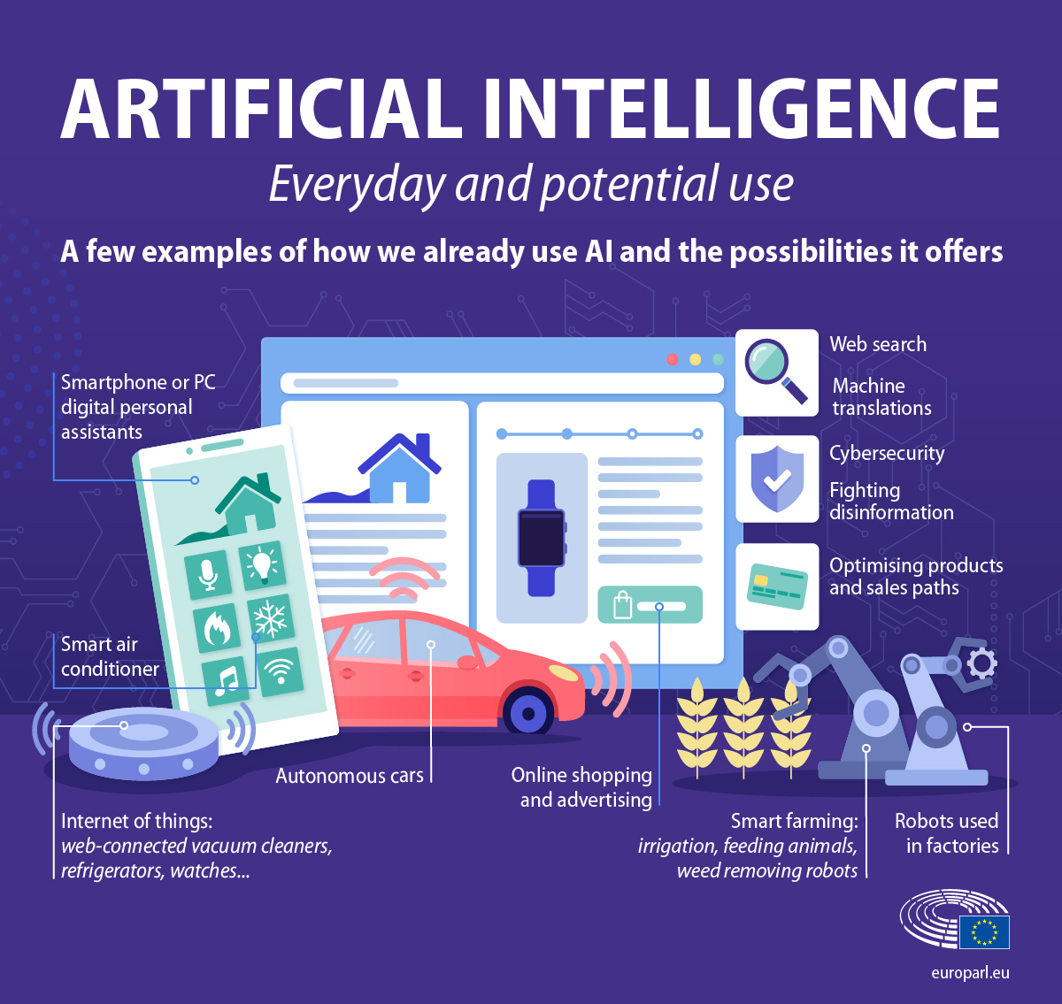
Application of AI
Already in daily life:
Voice assistants on Smartphone (Siri, Alexa)
Online shopping and advertising
Recommendation systems (Netflix, Amazon and YouTube)
Robots used in factories

Slide 15
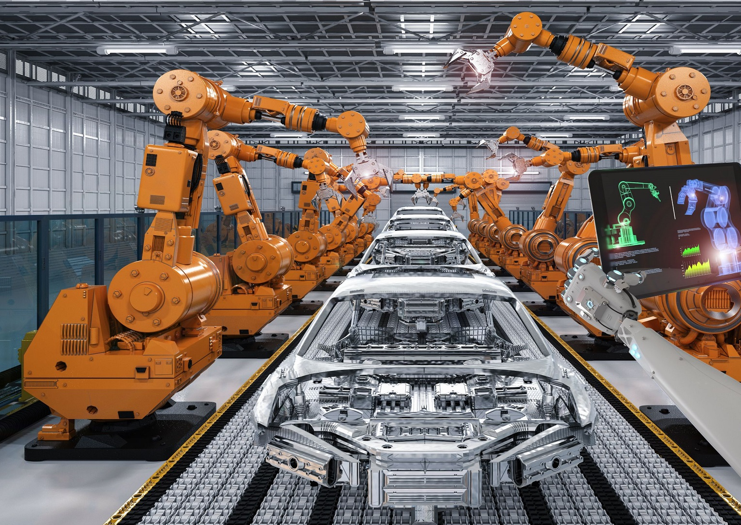
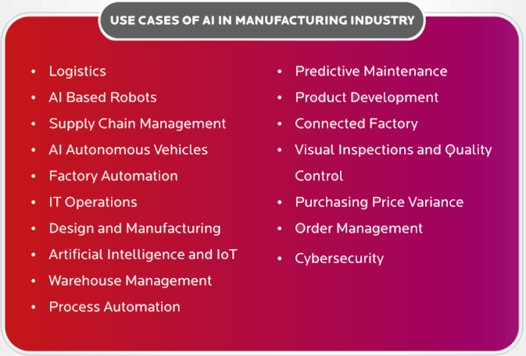
AI in industry
AI Based Robots
Product Development
Visual Inspections and Quality Control

Slide 16
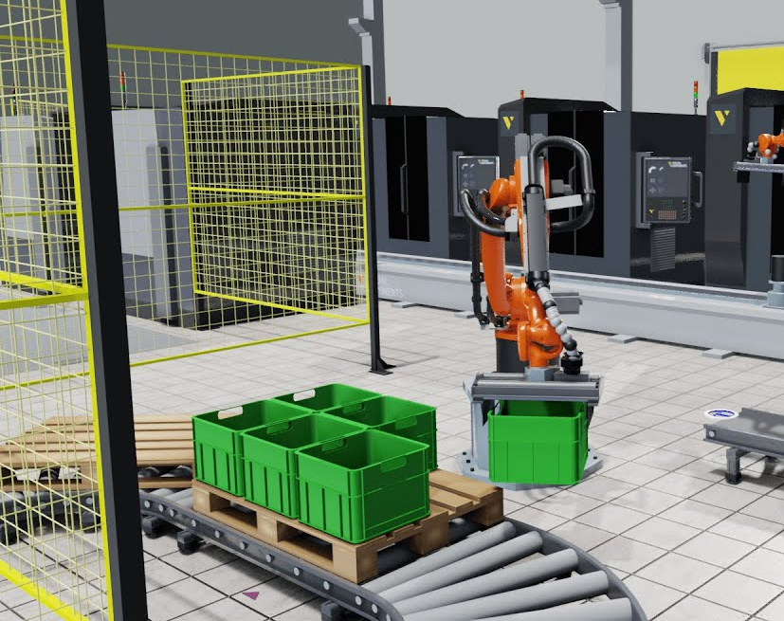
AI Based Robots Pick and Place vs. Bin Picking

Slide 17
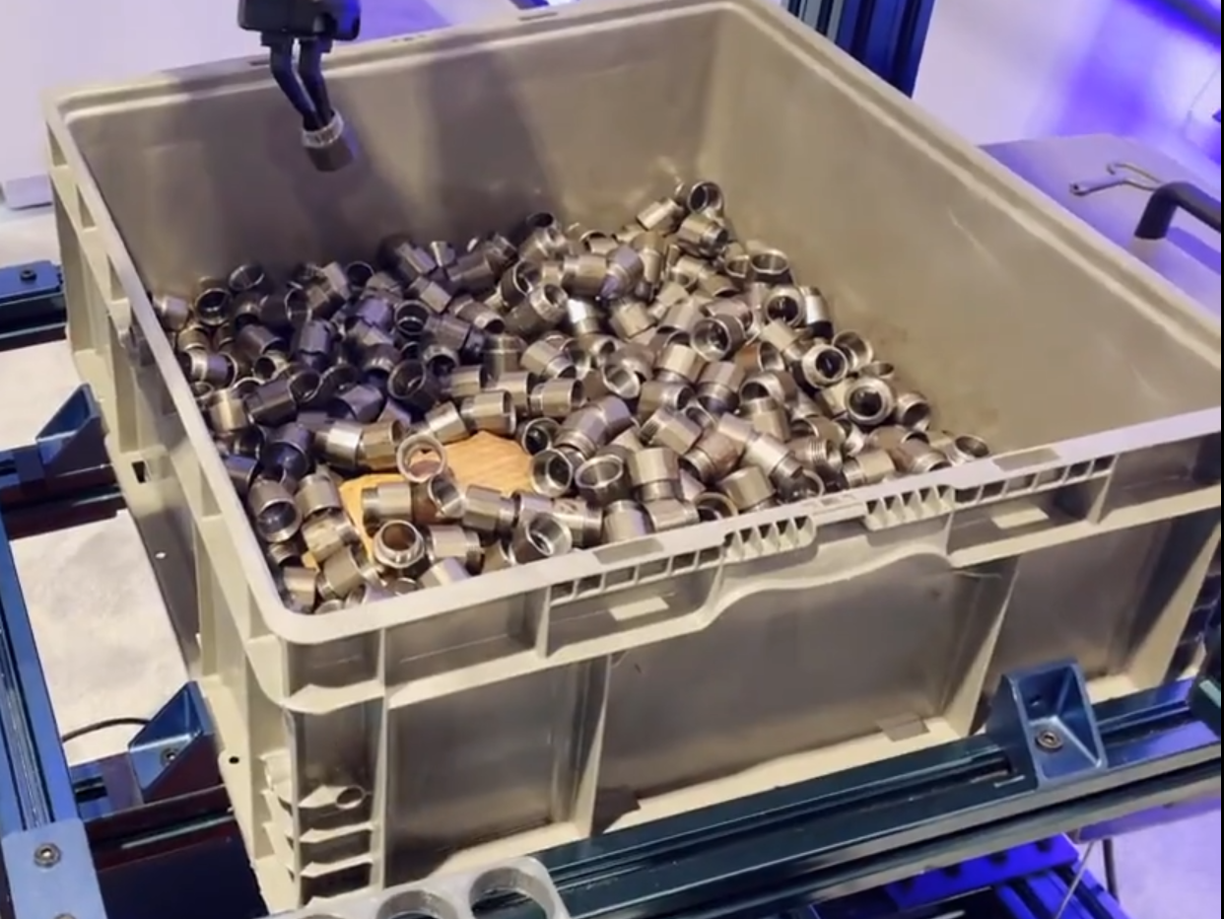
Change every time:
Position
Rotation
Obstacles

Slide 18
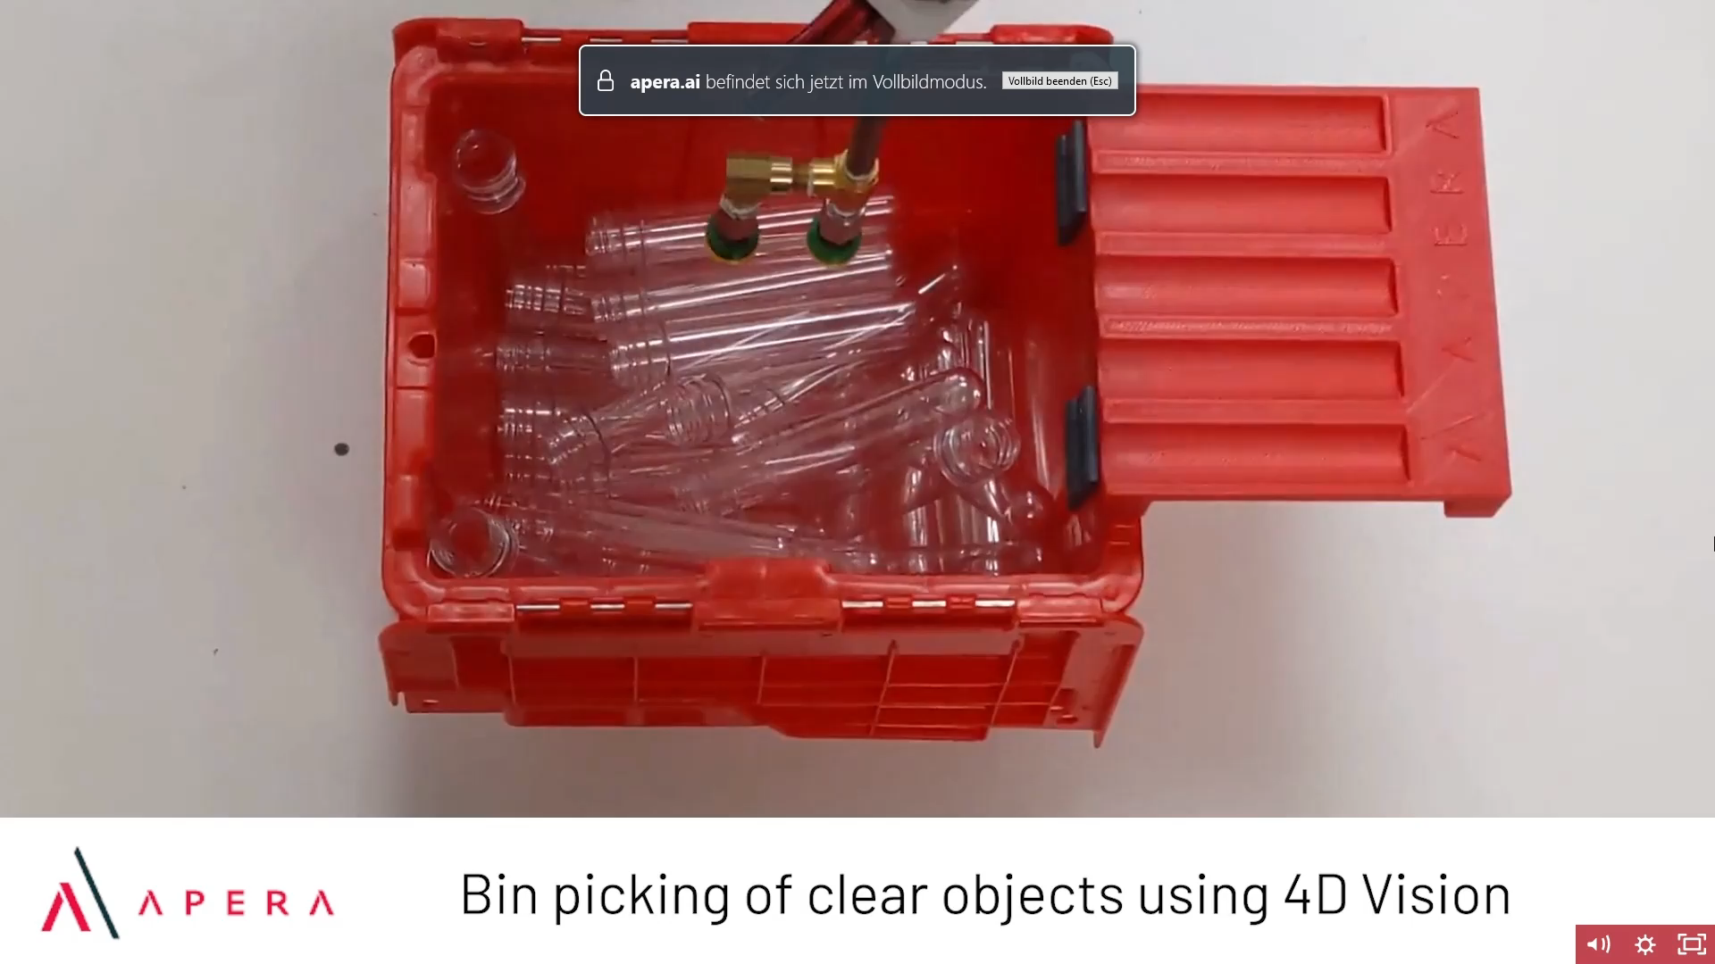
Steps:
Find part in bin
Plan path from pick to place avoiding singularities and joint limits
Enter bin in specific pose for part orientation
Avoid damaging nearby parts
Exit bin and place part in correct orientation without hitting environment

Slide 19
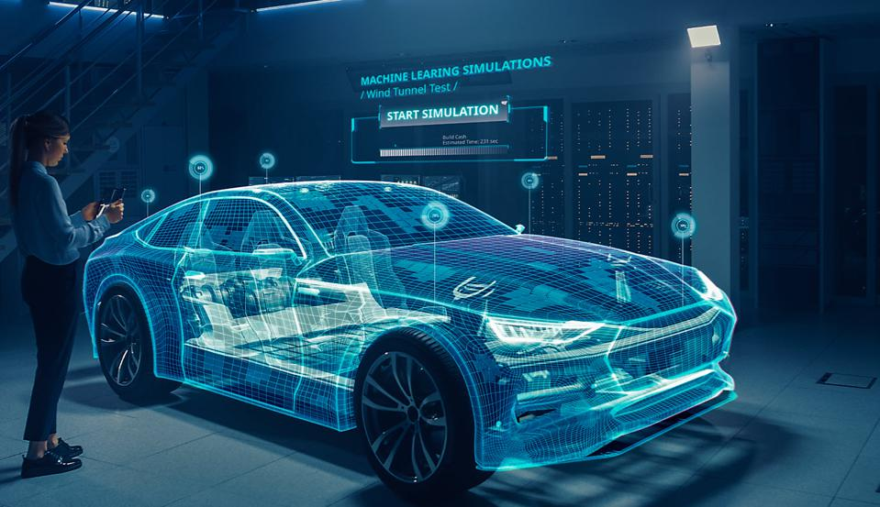
Product Development (Generative Design)

Slide 20
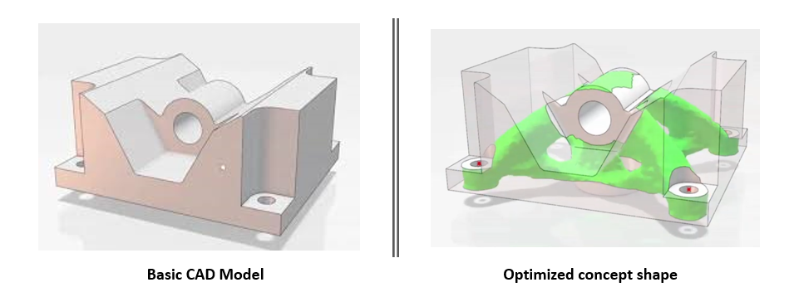
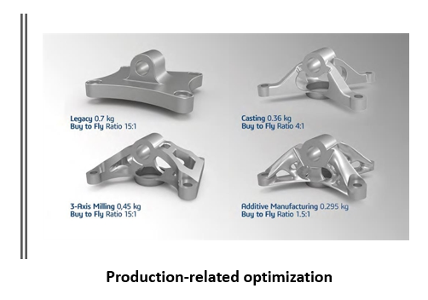
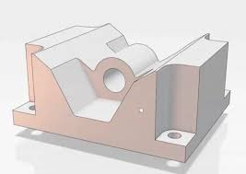
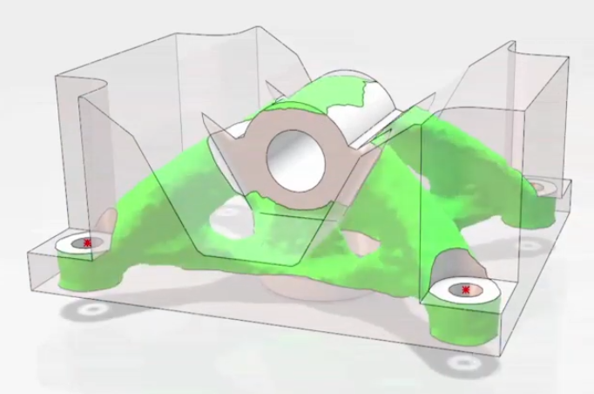
Product Development (Generative Design)
Basic CAD Model
Optimized concept shape

Slide 21
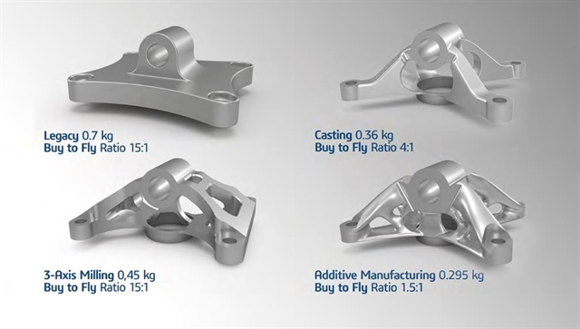
Product Development (Generative Design)
Advantages:
Minimize part weight
Maximize stiffness
Reduce cost
Optimize material usage

Slide 22
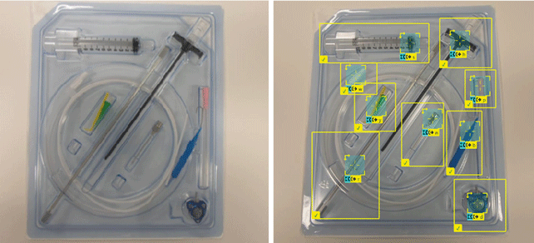
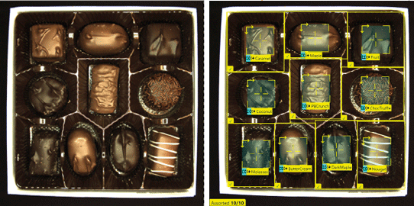
Visual Inspections and Quality Control
Detection of:
Positioning
Completeness
Cracks
Scratches
Color
Differences
External defects
Quality assurance for first aid kits
Praline box inspection

Slide 23


Defect detection in transparent tape material
senswork GmbH 84489 Burghausen / Germany

Slide 24
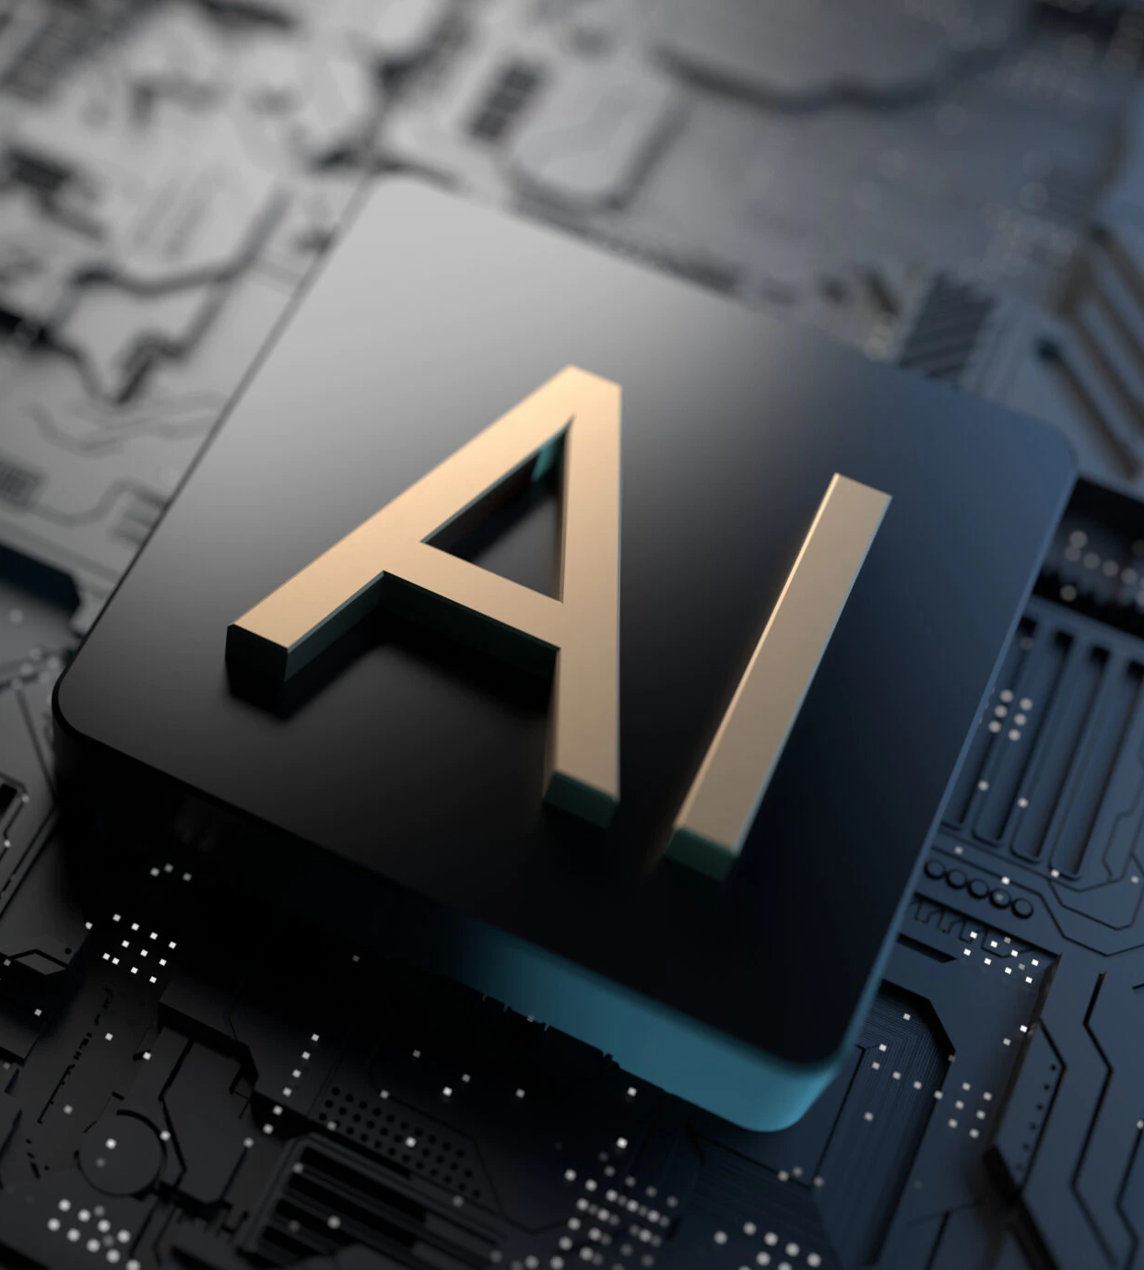

Conclusion sentence
"Overall, artificial intelligence has the potential to change the way we live and work, and it will be exciting to see how it continues to shape and improve various industries in the future."
by ChatGPT

Slide 25

Sources:
https://chat.openai.com
https://de.wikipedia.org/wiki/K%C3%BCnstliche_Intelligenz
https://www.computerweekly.com/de/definition/Kuenstliche-Intelligenz-KI
https://d3.harvard.edu/platform-rctom/submission/project-dreamcatcher-can-generative-design-accelerate-additive-manufacturing
https://www.birlasoft.com/articles/17-use-cases-of-ai-in-manufacturing
https://www.youtube.com/watch?v=OxIwIMgUJCE&ab_channel=NVIDIA
https://developer.nvidia.com/isaac-sim
https://www.igcv.fraunhofer.de/de/forschung/kompetenzen/kuenstliche_intelligenz.html
https://www.automate.org/blogs/training-an-industrial-robot-using-ai
https://www.iks.fraunhofer.de/de/themen/kuenstliche-intelligenz/kuenstliche-intelligenz-medizin.html
https://datasolut.com/was-ist-deep-learning/
https://levity.ai/blog/difference-machine-learning-deep-learning
https://senswork.com/de/
https://neurabites.com/muffin-or-chihuahua/
https://www.energid.com/blog/industrial-bin-picking-vs-pick-and-place
https://www.europarl.europa.eu/news/en/headlines/society/20200827STO85804/what-is-artificial-intelligence-and-how-is-it-used
https://toolkittech.com/artificial-intelligence-and-the-future-of-manufacturing/
https://www.state.gov/artificial-intelligence/

